Slide 1
COMPLETE
BUSINESS
STATISTICS
by
AMIR D. ACZEL
&
JAYAVEL SOUNDERPANDIAN
7th edition.
Prepared by Lloyd Jaisingh, Morehead State University
Chapter 13
Quality Control and Improvement
McGraw-Hill/Irwin
Copyright © 2009 by The McGraw-Hill Companies, Inc. All rights reserved.

Slide 2
_{13-<number>}
13
Quality Control and Improvement
Using Statistics
W. Edwards Deming Instructs
Statistics and Quality
The x-bar Chart
The R Chart and the s Chart
The p Chart
The c Chart
The x Chart

Slide 3
_{13-<number>}
13
LEARNING OBJECTIVES
After studying this chapter you will be able to:
Determine when to use control charts
Create control charts for sample means, ranges and standard deviations
Create control charts for sample proportions
Create control charts for the number of defectives
Draw Pareto charts using spreadsheet templates
Draw control charts using spreadsheet templates

Slide 4
13-3 Statistics and Quality
_{13-<number>}
A control chart is a time plot of a statistic, such as a sample mean, range, standard deviation, or proportion, with a center line and upper and lower control limits. The limits give the desired range of values for the statistic. When the statistic is outside the bounds, or when its time plot reveals certain patterns, the process may be out of control.
Value
This point is out of the control limits
UCL
3σ
Center
Line
3σ
LCL
Time
A process is considered in statistical control if it has no assignable causes, only natural variation.

Slide 5
Control Charts
_{13-<number>}
Value
Process is in control
Time
Value
Process mean varies over time: process is out of control
Time

Slide 6
Control Charts (Continued)
_{13-<number>}
Value
Process variance changes over time: process is out of control.
Time
Process mean and variance change over time: process is out of control.
Value
Time

Slide 7
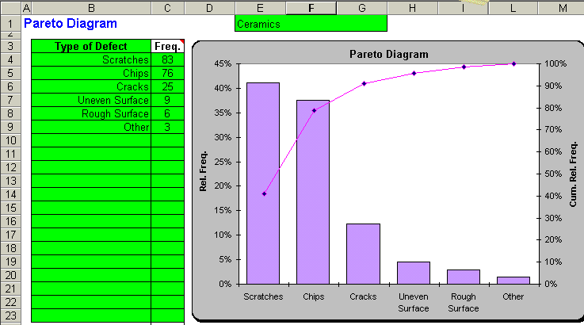
Pareto Diagrams – Using the Template
_{13-<number>}
A Pareto diagram is a bar chart of the various problems in production and their percentages, which must add to 100%.
A Pareto chart helps to identify the most significant problems and thus one can concentrate on their solutions rather than waste time and resources on unimportant causes.

Slide 8
Acceptance Sampling
_{13-<number>}
Finished products are grouped in lots before being shipped to customers.
The lots are numbered, and random samples from these lots are inspected for quality.
Such checks are made before the lots are shipped and after the lots arrive at their destination.
The random samples are measured to find out which and how many items do not meet specifications
A lot is rejected whenever the sample mean exceeds or falls below some pre-specified limit.

Slide 9
Acceptance Sampling
_{13-<number>}
For attribute data, the lot is rejected when the number of defectives or non-conforming items in the sample exceeds a pre-specified limit.
Acceptance sampling does not improve quality by itself.
It simply removes bad lots.
To improve quality, it is necessary to control the production process itself, removing any assignable causes and striving to reduce the variation in the process.

Slide 10
Six Sigma
_{13-<number>}
Six Sigma is a further innovation, beyond Deming’s work, in the field of quality assurance and control.
The purpose of Six Sigma is to push defect levels below a certain specified threshold.
Six Sigma helps to improve quality.
The key to Six Sigma is a precise definition of the production process with accurate measurements and valid collection of data.

Slide 11
Six Sigma
_{13-<number>}
It also involves detailed analysis to measure the relationships and causality of key factors in the production process.
Experimental Design is used to identify these key factors.
Strict control of the production process is exercised. Any variations are corrected, and the process is further monitored as it goes on line.
The essence of Six Sigma is the statistical methods described in this chapter.

Slide 12
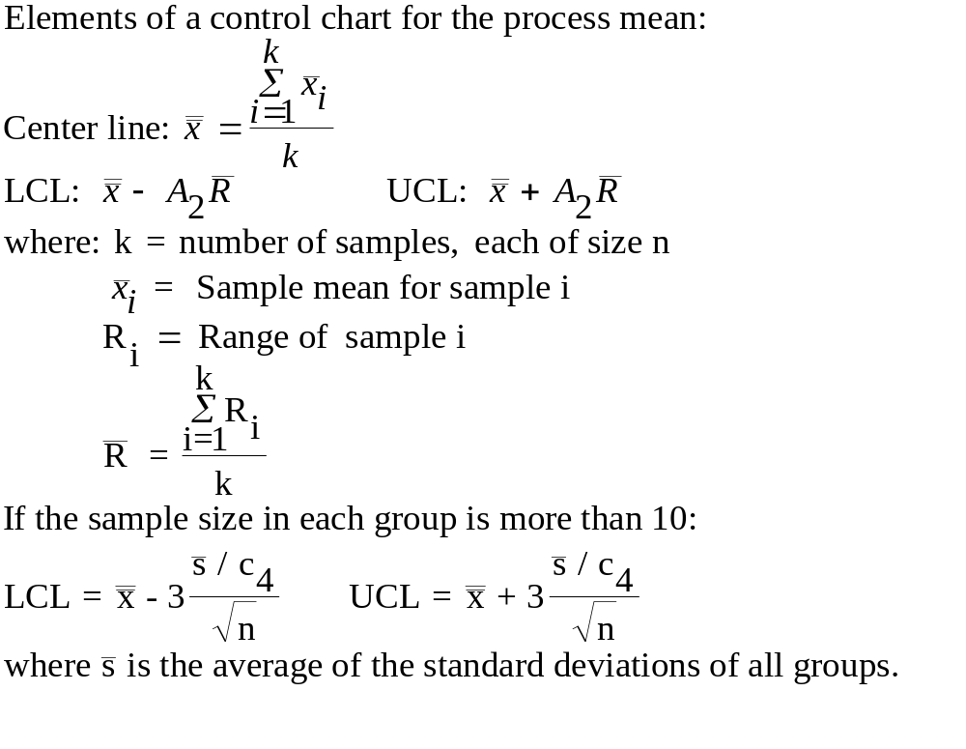
13-4 The X-Bar Chart: A Control Chart for the Process Mean
_{13-<number>}
n A₂ c₄
2 1.880 0.7979
3 1.023 0.8862
4 0.729 0.9213
5 0.577 0.9400
6 0.483 0.9515
7 0.419 0.9594
8 0.373 0.9650
9 0.337 0.9693
10 0.308 0.9727
15 0.223 0.9823
20 0.180 0.9869
25 0.153 0.9896

Slide 13
The X-Bar Chart: A Control Chart for the Process Mean (Continued)
_{13-<number>}
Tests for assignable causes:
  One point beyond 3σ (3s)
  Nine points in a row on one side of the center line
  Six points in a row steadily increasing or decreasing
  Fourteen points in a row alternating up and down
  Two out of three points in a row beyond 2σ (2s)
  Four out of five points in a row beyond 1σ (1s)
  Fifteen points in a row within 1σ (1s) of the center line
  Eight points in a row on both sides of the center line, all beyond 1σ (1s)

Slide 14
Tests for Assignable Causes
_{13-<number>}
Value
Test 1: One value beyond
3σ (3s)
3σ
2σ
1σ
1σ
2σ
3σ
Time
Value
Test 2: Nine points in a
row on one side
of the center line.
3σ
2σ
1σ
1σ
2σ
3σ
Time

Slide 15
Tests for Assignable Causes (Continued)
_{13-<number>}
Value
Test 3: Six points in a
row steadily
increasing or
decreasing.
3σ
2σ
1σ
1σ
2σ
3σ
Time
Value
Test 4: Fourteen points in
a row alternating
up and down.
3σ
2σ
1σ
1σ
2σ
3σ
Time

Slide 16
Tests for Assignable Causes (Continued)
_{13-<number>}
Value
Test 5: Two out of three
points in a row
beyond 2σ (2s)
3σ
2σ
1σ
1σ
2σ
3σ
Time
Value
Test 6: Four out of five
points in a row
beyond 1σ (1s)
3σ
2σ
1σ
1σ
2σ
3σ
Time

Slide 17
Tests for Assignable Causes (Continued)
_{13-<number>}
Value
Test 7: Fifteen points in a
row within 1σ
(1s) of the center
line.
3σ
2σ
1σ
1σ
2σ
3σ
Time
Value
Test 8: Eight points in a
row on both sides
of the center line,
all beyond 1σ (1s)
3σ
2σ
1σ
1σ
2σ
3σ
Time

Slide 18
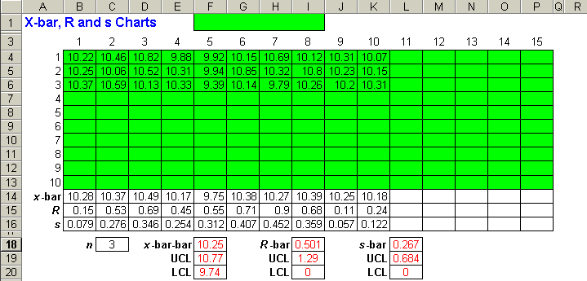
X-bar Chart: Example 13-1 – Using the Template
_{13-<number>}

Slide 19
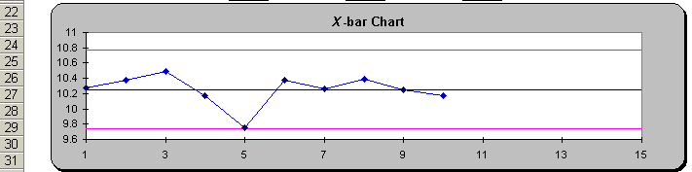
X-bar Chart: Example 13-1(continued) – Using the Template
_{13-<number>}
Note: The X-bar chart cannot be interpreted unless the R or s chart has been examined and is in control.

Slide 20
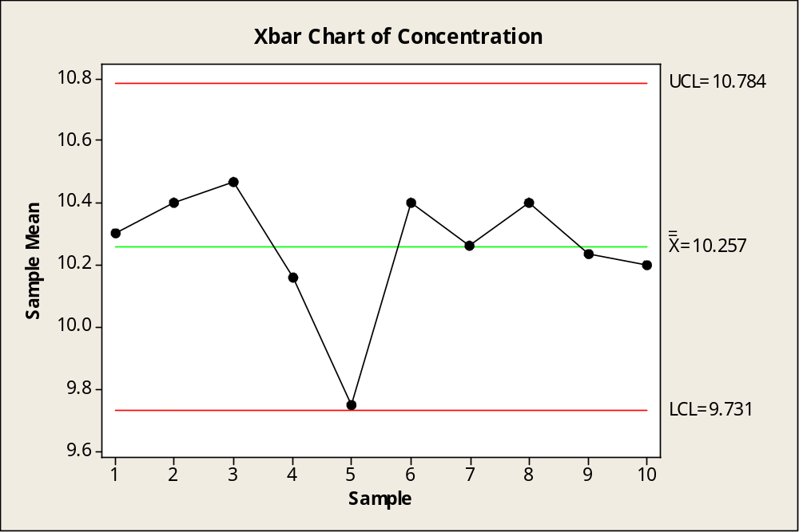
X-bar Chart: Example 13-1(continued) – Using Minitab
_{13-<number>}
Note: The X-bar chart cannot be interpreted unless the R or s chart has been examined and is in control.

Slide 21
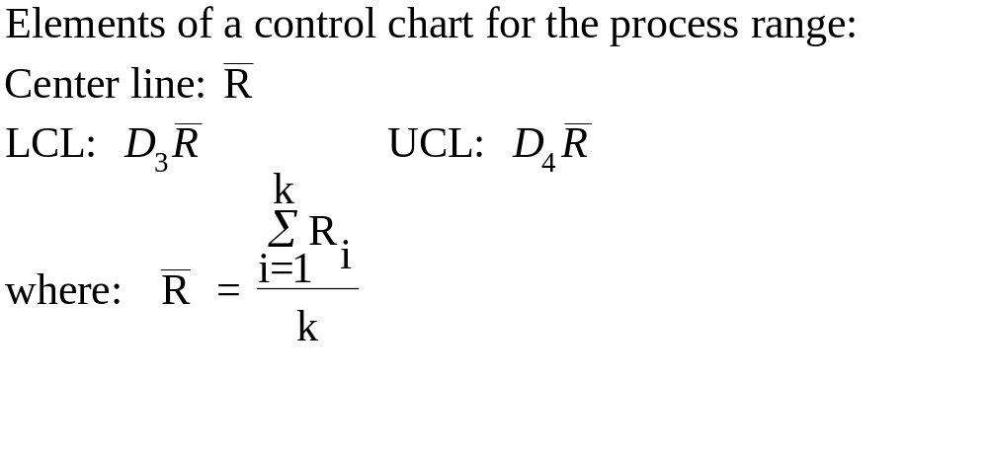
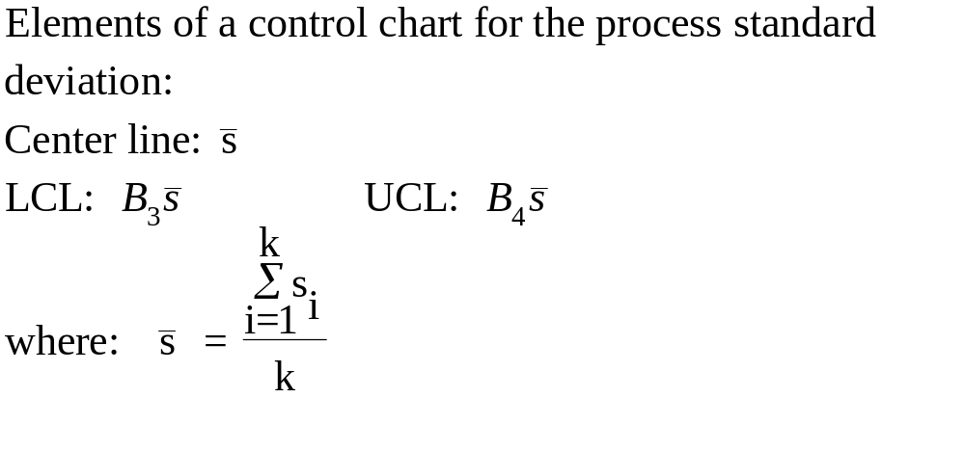
13-5 The R Chart and s Chart
_{13-<number>}
n D₃ D₄ B₃ B₄
2 0 3.267 0 3.267
3 0 2.575 0 2.568
4 0 2.282 0 2.266
5 0 2.115 0 2.089
6 0 2.004 0.030 1.970
7 0.076 1.924 0.118 1.882
8 0.136 1.864 0.185 1.815
9 0.184 1.816 0.239 1.761
10 0.223 1.777 0.284 1.716
15 0.348 1.652 0.428 1.572
20 0.414 1.586 0.510 1.490
25 0.459 1.541 0.565 1.435

Slide 22
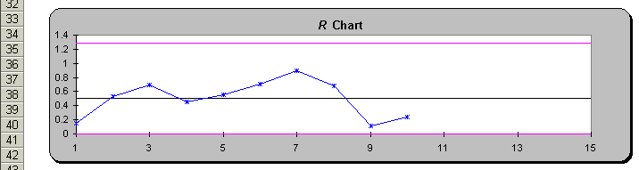
R Chart: Example 13-1 using the Template
_{13-<number>}
The process range seems to be in control.

Slide 23
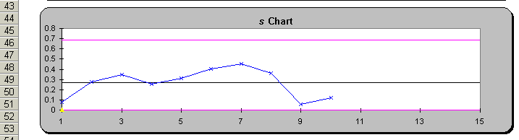
s Chart: Example 13-1 using the Template
_{13-<number>}
The process standard deviation seems to be in control.

Slide 24
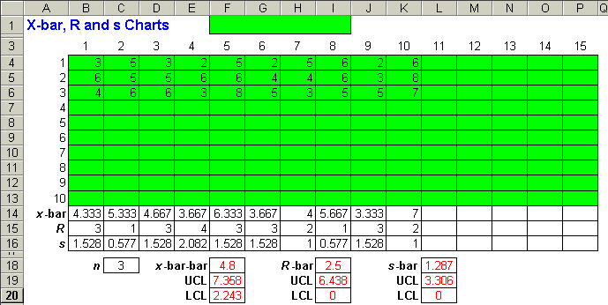
Example 13-2 using the Template
_{13-<number>}

Slide 25
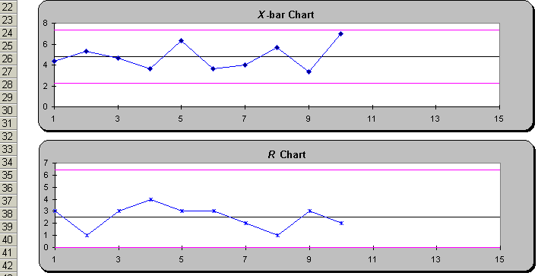
Example 13-2 using the Template - Continued
_{13-<number>}

Slide 26
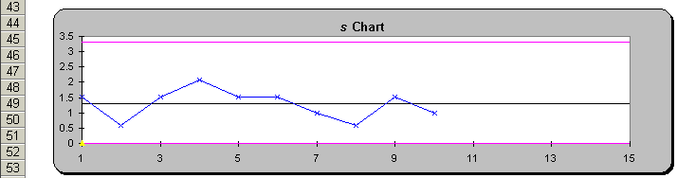
Example 13-2 using the Template - Continued
_{13-<number>}
Based on the x-bar, R, and s charts, the process seems to be in control.

Slide 27
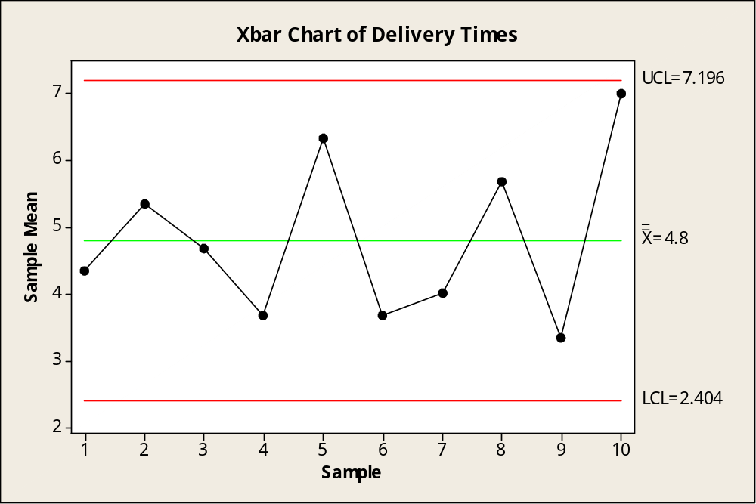
Example 13-2 using Minitab
_{13-<number>}

Slide 28
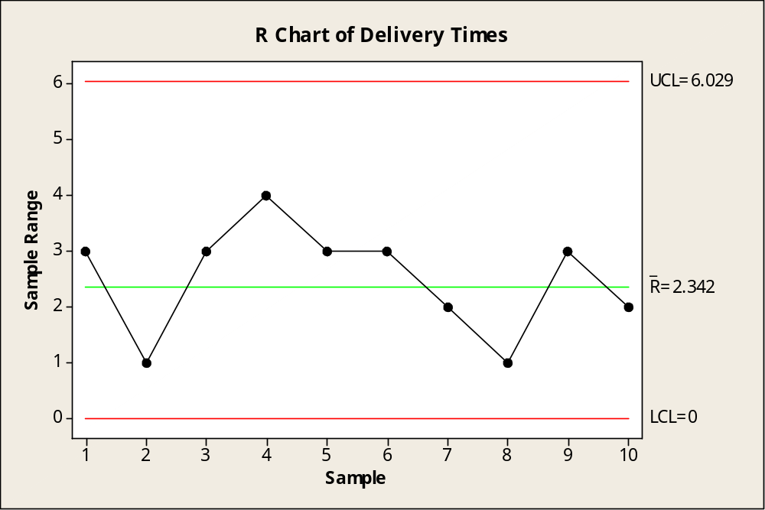
Example 13-2 using Minitab
_{13-<number>}

Slide 29
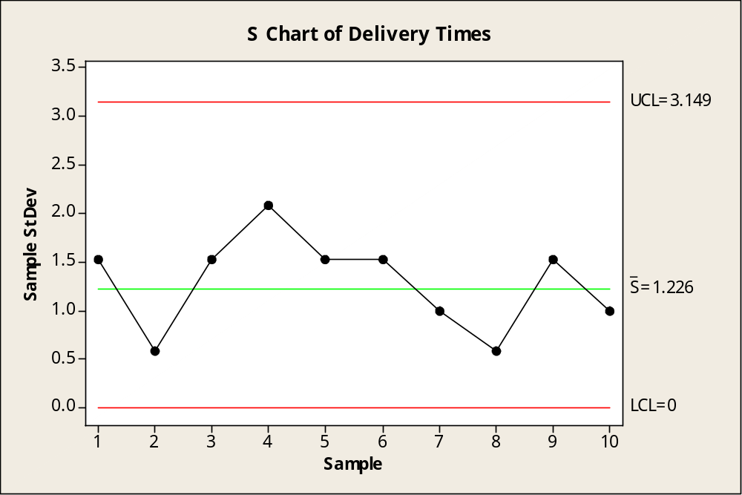
Example 13-2 using Minitab
_{13-<number>}
Based on the x-bar, R, and s charts, the process seems to be in control.

Slide 30
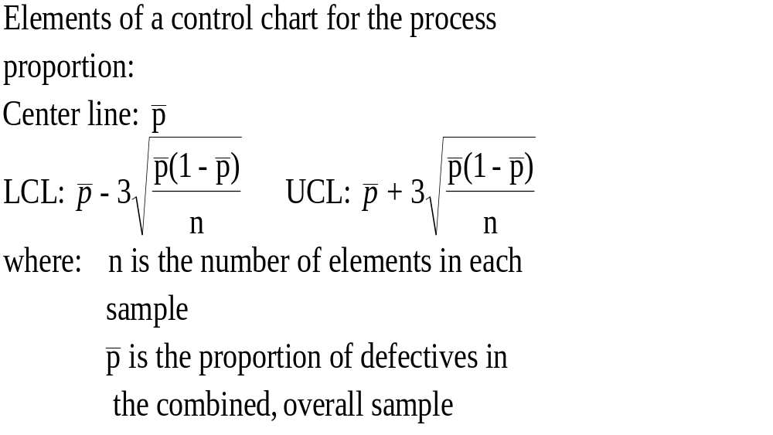
13-6 The p Chart: Proportion of Defective Items
_{13-<number>}

Slide 31
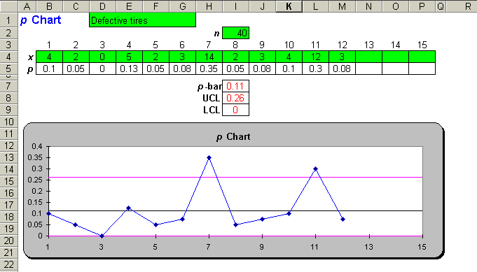
13-6 The p Chart: Proportion of Defective Items – Using the Template for Example 13-3
_{13-<number>}
Process is out of control – Two points fall outside the control limit

Slide 32
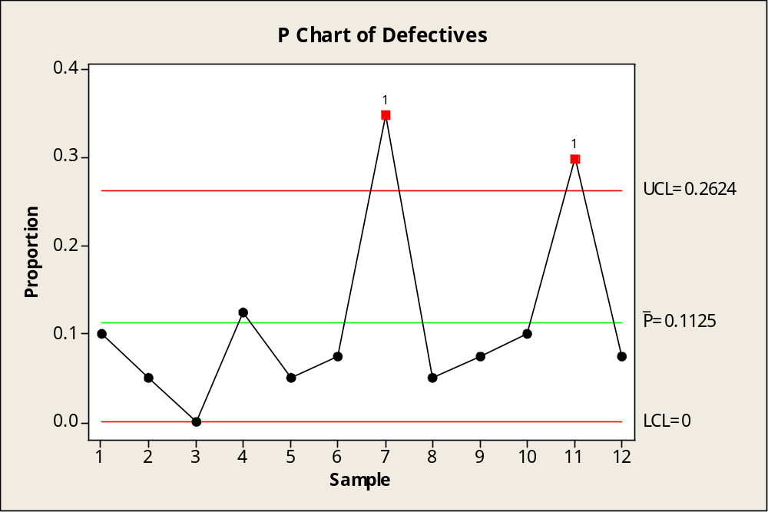
13-6 The p Chart: Proportion of Defective Items – Using Minitab for Example 13-3
_{13-<number>}
Process is out of control – Two points fall outside the control limit

Slide 33
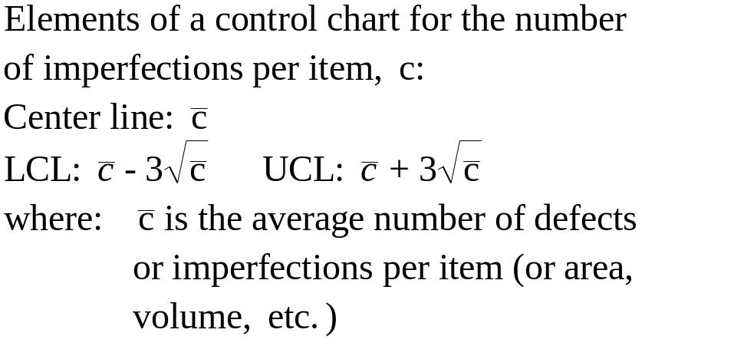
13-7 The c Chart: (Defects Per Item)
_{13-<number>}

Slide 34
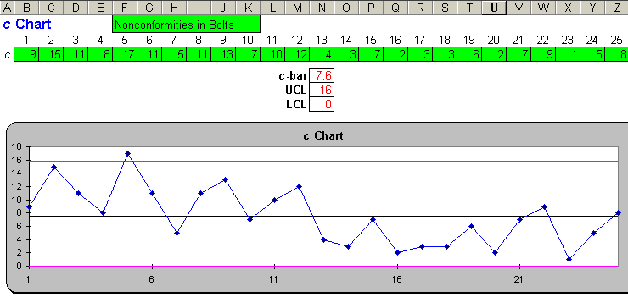
The c Chart: Example 13-4 using the Template
_{13-<number>}
Observe that one observation is outside the upper control limit, indicating that the process may be out of control. The general downward trend should be investigated.

Slide 35
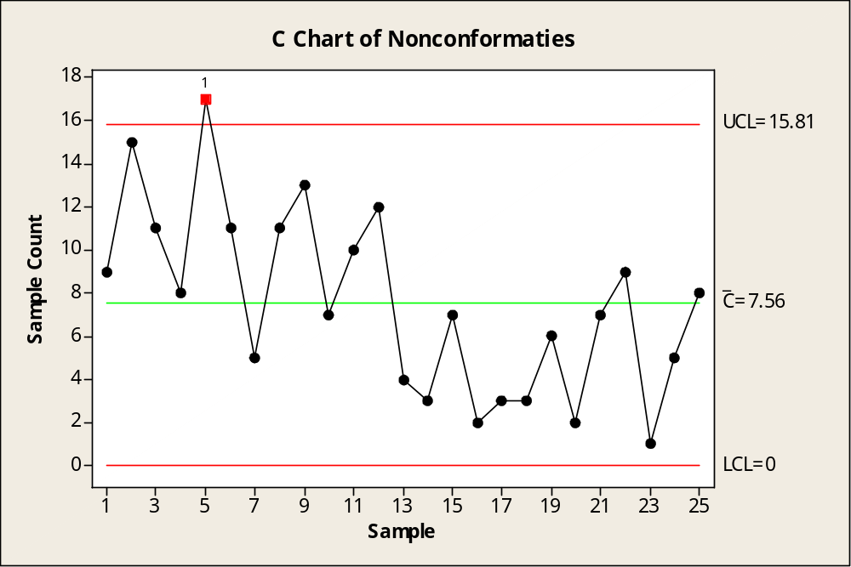
The c Chart: Example 13-4 using Minitab
_{13-<number>}
Observe that one observation is outside the upper control limit, indicating that the process may be out of control. The general downward trend should be investigated.

Slide 36

13-8 The x Chart
_{13-<number>}
Sometimes we are interested in controlling the process mean, but our observations come so slowly from the production process that we cannot aggregate them into groups. In such case we may consider an x chart. An x-chart is a chart for the raw values of the variable in question.
The chart is effective if the variable has an approximate normal distribution. The bounds are 3 standard deviations from the mean of the process.

Slide 37
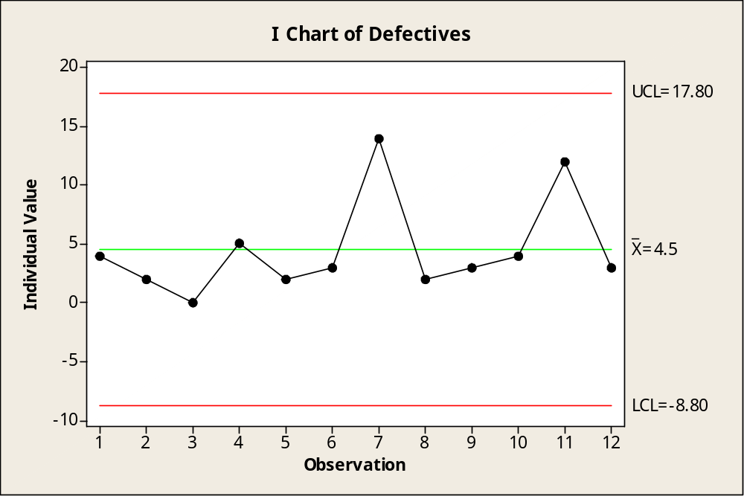
13-8 The x Chart for Example 13-3 – Using Minitab
_{13-<number>}
NOTE: The X-Chart
Is same as the
Individual chart in
Minitab

Slide 38
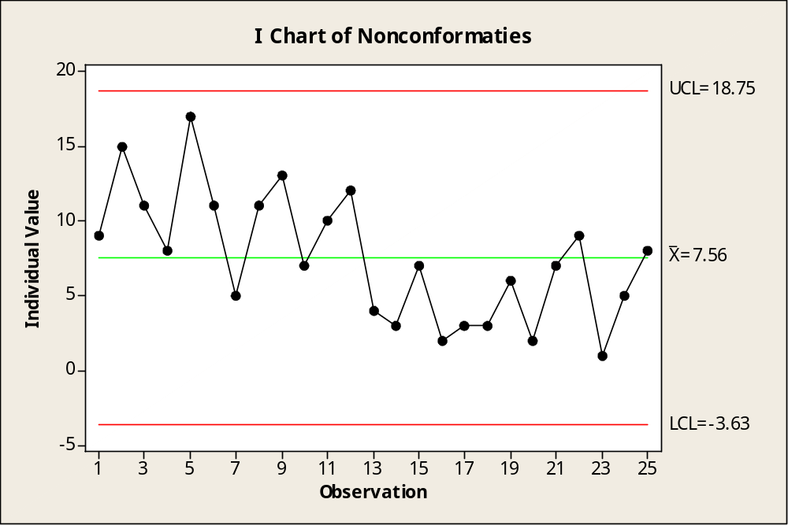
13-8 The x Chart for Example 13-4 – Using Minitab
_{13-<number>}

